Slide 1
Cryptography and Network Security Chapter 2
Notes:
‹#›
Lecture slides by Lawrie Brown for “Cryptography and Network Security”, 5/e, by William Stallings, Chapter 2 – “Classical Encryption Techniques”.

Slide 2
Chapter 2 – Classical Encryption Techniques
"I am fairly familiar with all the forms of secret writings, and am myself the author of a trifling monograph upon the subject, in which I analyze one hundred and sixty separate ciphers," said Holmes..
—The Adventure of the Dancing Men, Sir Arthur Conan Doyle
Notes:
‹#›
Opening quote.

Slide 3
Symmetric Encryption
or conventional / private-key / single-key
sender and recipient share a common key
all classical encryption algorithms are private-key
was only type prior to invention of public-key in 1970’s
and by far most widely used (still)
is significantly faster than public-key crypto
Notes:
‹#›
Symmetric encryption, also referred to as conventional encryption or single-key encryption, was the only type of encryption in use prior to the development of public-key encryption in the 1970s. It remains by far the most widely used of the two types of encryption. All traditional schemes are symmetric / single key / private-key encryption algorithms, with a single key, used for both encryption and decryption. Since both sender and receiver are equivalent, either can encrypt or decrypt messages using that common key.

Slide 4
Some Basic Terminology
plaintext - original message
ciphertext - coded message
cipher - algorithm for transforming plaintext to ciphertext
key - info used in cipher known only to sender/receiver
encipher (encrypt) - converting plaintext to ciphertext
decipher (decrypt) - recovering plaintext from ciphertext
cryptography - study of encryption principles/methods
cryptanalysis (codebreaking) - study of principles/ methods of deciphering ciphertext without knowing key
cryptology - field of both cryptography and cryptanalysis
Notes:
‹#›
Briefly review some terminology used throughout the course.

Slide 5
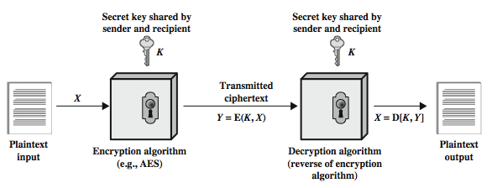
Symmetric Cipher Model
Notes:
‹#›
Detail the five ingredients of the symmetric cipher model, shown in Stallings Figure 2.1:
plaintext - original message
encryption algorithm – performs substitutions/transformations on plaintext
secret key – control exact substitutions/transformations used in encryption algorithm
ciphertext - scrambled message
decryption algorithm – inverse of encryption algorithm

Slide 6
Requirements
two requirements for secure use of symmetric encryption:
a strong encryption algorithm
a secret key known only to sender / receiver
mathematically have:
Y = E(K, X) = E_{K}(X) = {X}_{K}
X = D(K, Y) = D_{K}(Y)
assume encryption algorithm is known
Kerckhoff’s Principle: security in secrecy of key alone, not in obscurity of the encryption algorithm
implies a secure channel to distribute key
Central problem in symmetric cryptography
Notes:
‹#›
There are two requirements for secure use of conventional encryption that mean we assume that it is impractical to decrypt a message on the basis of the cipher- text plus knowledge of the encryption/decryption algorithm, and hence do not need to keep the algorithm secret; rather we only need to keep the key secret. This feature of symmetric encryption is what makes it feasible for widespread use. It allows easy distribution of s/w and h/w implementations.
Can take a closer look at the essential elements of a symmetric encryption scheme: mathematically it can be considered a pair of functions with: plaintext X, ciphertext Y, key K, encryption algorithm E, decryption algorithm D. The intended receiver, in possession of the key, is able to invert the transformation. An opponent, observing Y but not having access to K or X, may attempt to recover X or K.

Slide 7
Cryptography
can characterize cryptographic system by:
type of encryption operations used
substitution
transposition
product
number of keys used
single-key or private
two-key or public
way in which plaintext is processed
block
stream
Notes:
‹#›
Cryptographic systems can be characterized along these three independent dimensions.
The type of operations used for transforming plaintext to ciphertext. All encryption algorithms are based on two general principles: substitution, in which each element in the plaintext (bit, letter, group of bits or letters) is mapped into another element, and transposition, in which elements in the plaintext are rearranged. The fundamental requirement is that no information be lost (that is, that all operations are reversible). Most systems, referred to as product systems, involve multiple stages of substitutions and transpositions.
The number of keys used. If both sender and receiver use the same key, the system is referred to as symmetric, single-key, secret-key, or conventional encryption. If the sender and receiver use different keys, the system is referred to as asymmetric, two-key, or public-key encryption.
The way in which the plaintext is processed. A block cipher processes the input one block of elements at a time, producing an output block for each input block. A stream cipher processes the input elements continuously, producing output one element at a time, as it goes along.

Slide 8
Cryptanalysis
objective to recover key not just message
general approaches:
cryptanalytic attack
brute-force attack
if either succeed all key use compromised
Notes:
‹#›
Typically objective is to recover the key in use rather then simply to recover the plaintext of a single ciphertext. There are two general approaches:
Cryptanalysis: relies on the nature of the algorithm plus perhaps some knowledge of the general characteristics of the plaintext or even some sample plaintext- ciphertext pairs. This type of attack exploits the characteristics of the algorithm to attempt to deduce a specific plaintext or to deduce the key being used.
Brute-force attacks try every possible key on a piece of ciphertext until an intelligible translation into plaintext is obtained. On average,half of all possible keys must be tried to achieve success.
If either type of attack succeeds in deducing the key, the effect is catastrophic: All future and past messages encrypted with that key are compromised.

Slide 9
Cryptanalytic Attacks
ciphertext only
only know algorithm & ciphertext, is statistical, can identify plaintext
known plaintext
know/suspect plaintext & ciphertext
chosen plaintext
select plaintext and obtain ciphertext
chosen ciphertext
select ciphertext and obtain plaintext
chosen text
select plaintext or ciphertext to en/decrypt
Notes:
‹#›
Stallings Table 2.1 summarizes the various types of cryptanalytic attacks, based on the amount of information known to the cryptanalyst, from least to most. The most difficult problem is presented when all that is available is the ciphertext only. In some cases, not even the encryption algorithm is known, but in general we can assume that the opponent does know the algorithm used for encryption. Then with increasing information have the other attacks. Generally, an encryption algorithm is designed to withstand a known-plaintext attack.

Slide 10
Cipher Strength
unconditional security
no matter how much computer power or time is available, the cipher cannot be broken since the ciphertext provides insufficient information to uniquely determine the corresponding plaintext
computational security
given limited computing resources (e.g. time needed for calculations is greater than age of universe), the cipher cannot be broken
Notes:
‹#›
Two more definitions are worthy of note. An encryption scheme is unconditionally secure if the ciphertext generated by the scheme does not contain enough information to determine uniquely the corresponding plaintext, no matter how much ciphertext is available. An encryption scheme is said to be computationally secure if either the cost of breaking the cipher exceeds the value of the encrypted information, or the time required to break the cipher exceeds the useful lifetime of the information. Unconditional security would be nice, but the only known such cipher is the one-time pad (later).
For all reasonable encryption algorithms, we have to assume computational security where it either takes too long, or is too expensive, to bother breaking the cipher.

Slide 11
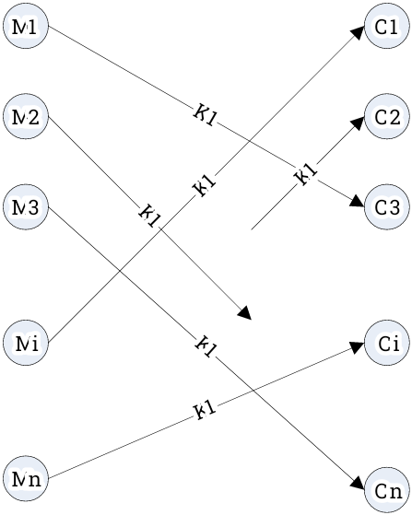

Encryption Mappings
A given key (k)
Maps any message Mi to some ciphertext E(k,Mi)
Ciphertext image of Mi is unique to Mi under k
Plaintext pre-image of Ci is unique to Ci under k
Notation
key k and Mi in M, Ǝ! Cj in C such that E(k,Mi) = Cj
key k and ciphertext Ci in C, Ǝ! Mj in M such that E(k,Mj) = Ci
E_{k}(.) is “one-to-one” (injective)
If |M|=|C| it is also “onto” (surjective), and hence bijective.
M=set of all plaintexts
C=set of all ciphertexts
Notes:
‹#›
Two more definitions are worthy of note. An encryption scheme is unconditionally secure if the ciphertext generated by the scheme does not contain enough information to determine uniquely the corresponding plaintext, no matter how much ciphertext is available. An encryption scheme is said to be computationally secure if either the cost of breaking the cipher exceeds the value of the encrypted information, or the time required to break the cipher exceeds the useful lifetime of the information. Unconditional security would be nice, but the only known such cipher is the one-time pad (later).
For all reasonable encryption algorithms, we have to assume computational security where it either takes too long, or is too expensive, to bother breaking the cipher.

Slide 12
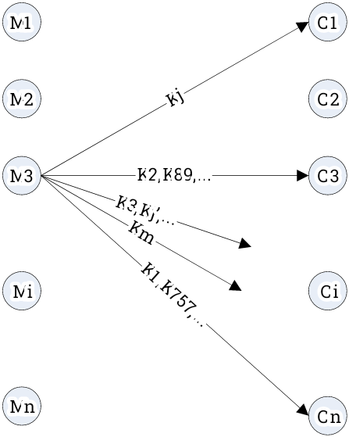

Encryption Mappings (2)
A given plaintext (Mi)
Mi is mapped to some ciphertext E(K,Mi) by every key k
Different keys may map Mi to the same ciphertext
There may be some ciphertexts to which Mi is never mapped by any key
Notation
key k and Mi in M, Ǝ! ciphertext Cj in C such that E(k,Mi) = Cj
It is possible that there are keys k and k’ such that E(k,Mi) = E(k’,Mi)
There may be some ciphertext Cj for which Ǝ key k such that E(k,Mi) = Cj
Notes:
‹#›
Two more definitions are worthy of note. An encryption scheme is unconditionally secure if the ciphertext generated by the scheme does not contain enough information to determine uniquely the corresponding plaintext, no matter how much ciphertext is available. An encryption scheme is said to be computationally secure if either the cost of breaking the cipher exceeds the value of the encrypted information, or the time required to break the cipher exceeds the useful lifetime of the information. Unconditional security would be nice, but the only known such cipher is the one-time pad (later).
For all reasonable encryption algorithms, we have to assume computational security where it either takes too long, or is too expensive, to bother breaking the cipher.

Slide 13
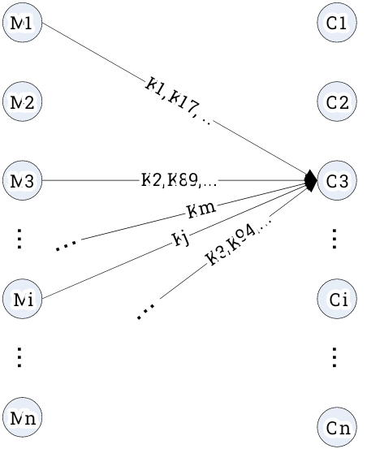

Encryption Mappings (3)
A ciphertext (Ci)
Has a unique plaintext pre-image under each k
May have two keys that map the same plaintext to it
There may be some plaintext Mj such that no key maps Mj to Ci
Notation
key k and ciphertext Ci in C, Ǝ! Mj in M such that E(k,Mj) = Ci
There may exist keys k, k’ and plaintext Mj such that E(k,Mj) = E(k’,Mj) = Ci
There may exist plaintext Mj such that Ǝ key k such that E(k,Mj) = Ci
Notes:
‹#›
Two more definitions are worthy of note. An encryption scheme is unconditionally secure if the ciphertext generated by the scheme does not contain enough information to determine uniquely the corresponding plaintext, no matter how much ciphertext is available. An encryption scheme is said to be computationally secure if either the cost of breaking the cipher exceeds the value of the encrypted information, or the time required to break the cipher exceeds the useful lifetime of the information. Unconditional security would be nice, but the only known such cipher is the one-time pad (later).
For all reasonable encryption algorithms, we have to assume computational security where it either takes too long, or is too expensive, to bother breaking the cipher.

Slide 14
Encryption Mappings (4)
Under what conditions will there always be some key that maps some plaintext to a given ciphertext?
If for an intercepted ciphertext c_{j}, there is some plaintext m_{i} for which there does not exist any key k that maps m_{i} to c_{j}, then the attacker has learned something
If the attacker has ciphertext c_{j} and known plaintext m_{i}, then many keys may be eliminated
Notes:
‹#›
Two more definitions are worthy of note. An encryption scheme is unconditionally secure if the ciphertext generated by the scheme does not contain enough information to determine uniquely the corresponding plaintext, no matter how much ciphertext is available. An encryption scheme is said to be computationally secure if either the cost of breaking the cipher exceeds the value of the encrypted information, or the time required to break the cipher exceeds the useful lifetime of the information. Unconditional security would be nice, but the only known such cipher is the one-time pad (later).
For all reasonable encryption algorithms, we have to assume computational security where it either takes too long, or is too expensive, to bother breaking the cipher.

Slide 15
Brute Force Search
always possible to simply try every key
most basic attack, exponential in key length
assume either know / recognise plaintext
Key Size (bits) | Number of Alternative Keys | Time required at 1 decryption/µs | Time required at 10⁶ decryptions/µs
32 | 2³² = 4.3 × 10⁹ | 2³¹ µs = 35.8 minutes | 2.15 milliseconds
56 | 2⁵⁶ = 7.2 × 10¹⁶ | 2⁵⁵ µs = 1142 years | 10.01 hours
128 | 2¹²⁸ = 3.4 × 10³⁸ | 2¹²⁷ µs = 5.4 × 10²⁴ years | 5.4 × 10¹⁸ years
168 | 2¹⁶⁸ = 3.7 × 10⁵⁰ | 2¹⁶⁷ µs = 5.9 × 10³⁶ years | 5.9 × 10³⁰ years
26 characters (permutation) | 26! = 4 × 10²⁶ | 2 × 10²⁶ µs = 6.4 × 10¹² years | 6.4 × 10⁶ years
Notes:
‹#›
A brute-force attack involves trying every possible key until an intelligible translation of the ciphertext into plaintext is obtained. On average, half of all possible keys must be tried to achieve success. Stallings Table 2.2 shows how much time is required to conduct a brute-force attack, for various common key sizes (DES is 56, AES is 128, Triple-DES is 168, plus general mono-alphabetic cipher), where either a single system or a million parallel systems, are used.

Slide 16
Classical Substitution Ciphers
where letters of plaintext are replaced by other letters or by numbers or symbols
or if plaintext is viewed as a sequence of bits, then substitution involves replacing plaintext bit patterns with ciphertext bit patterns
Notes:
‹#›
In this section and the next, we examine a sampling of what might be called classical encryption techniques. A study of these techniques enables us to illustrate the basic approaches to symmetric encryption used today and the types of cryptanalytic attacks that must be anticipated. The two basic building blocks of all encryption technique are substitution and transposition. We examine these in the next two sections. Finally, we discuss a system that combine both substitution and transposition.
A substitution technique is one in which the letters of plaintext are replaced by other letters or by numbers or symbols. If the plaintext is viewed as a sequence of bits, then substitution involves replacing plaintext bit patterns with ciphertext bit patterns.

Slide 17
Caesar Cipher
earliest known substitution cipher
by Julius Caesar
first attested use in military affairs
replaces each letter by 3rd letter on
example:
meet me after the toga party
PHHW PH DIWHU WKH WRJD SDUWB
Notes:
‹#›
Substitution ciphers form the first of the fundamental building blocks. The core idea is to replace one basic unit (letter/byte) with another. Whilst the early Greeks described several substitution ciphers, the first attested use in military affairs of one was by Julius Caesar, described by him in Gallic Wars (cf. Kahn pp83-84). Still call any cipher using a simple letter shift a caesar cipher, not just those with shift 3.

Slide 18
Caesar Cipher
can define transformation as:
a b c d e f g h i j k l m n o p q r s t u v w x y z = IN
D E F G H I J K L M N O P Q R S T U V W X Y Z A B C = OUT
mathematically give each letter a number
a b c d e f g h i j k l m n o p q r s t u v w x y z
0 1 2 3 4 5 6 7 8 9 10 11 12 13 14 15 16 17 18 19 20 21 22 23 24 25
then have Caesar (rotation) cipher as:
c = E(k, p) = (p + k) mod (26)
p = D(k, c) = (c – k) mod (26)
Notes:
‹#›
This mathematical description uses modulo (clock) arithmetic. Here, when you reach Z you go back to A and start again. Mod 26 implies that when you reach 26, you use 0 instead (ie the letter after Z, or 25 + 1 goes to A or 0).
Example: howdy (7,14,22,3,24) encrypted using key f (ie a shift of 5) is MTBID

Slide 19
Cryptanalysis of Caesar Cipher
only have 26 possible ciphers
A maps to A,B,..Z
could simply try each in turn
a brute force search
given ciphertext, just try all shifts of letters
do need to recognize when have plaintext
eg. break ciphertext "GCUA VQ DTGCM"
Notes:
‹#›
With a caesar cipher, there are only 26 possible keys, of which only 25 are of any use, since mapping A to A etc doesn't really obscure the message! Note this basic rule of cryptanalysis "check to ensure the cipher operator hasn't goofed and sent a plaintext message by mistake"!
Can try each of the keys (shifts) in turn, until can recognise the original message. See Stallings Fig 2.3 for example of search.
Note: as mentioned before, do need to be able to recognise when have an original message (ie is it English or whatever). Usually easy for humans, hard for computers. Though if using say compressed data could be much harder.
Example "GCUA VQ DTGCM" when broken gives "easy to break", with a shift of 2 (key C).

Slide 20
Affine Cipher
broaden to include multiplication
can define affine transformation as:
c = E(k, p) = (ap + b) mod (26)
p = D(k, c) = (a⁻¹(c – b)) mod (26)
key k=(a,b)
a must be relatively prime to 26
so there exists unique inverse a⁻¹
Notes:
‹#›
This mathematical description uses modulo (clock) arithmetic. Here, when you reach Z you go back to A and start again. Mod 26 implies that when you reach 26, you use 0 instead (ie the letter after Z, or 25 + 1 goes to A or 0).
Example: howdy (7,14,22,3,24) encrypted using key f (ie a shift of 5) is MTBID

Slide 21
Affine Cipher - Example
example k=(17,3):
a b c d e f g h i j k l m n o p q r s t u v w x y z = IN
D U L C T K B S J A R I Z Q H Y P G X O F W N E V M = OUT
example:
meet me after the toga party
ZTTO ZT DKOTG OST OHBD YDGOV
Now how many keys are there?
12 x 26 = 312
Still can be brute force attacked!
Notes:
‹#›
This mathematical description uses modulo (clock) arithmetic. Here, when you reach Z you go back to A and start again. Mod 26 implies that when you reach 26, you use 0 instead (ie the letter after Z, or 25 + 1 goes to A or 0).
Example: howdy (7,14,22,3,24) encrypted using key f (ie a shift of 5) is MTBID

Slide 22
Monoalphabetic Cipher
A Monoalphabetic Cipher is a substitution cipher where each letter of the plaintext is replaced with a corresponding letter from a fixed substitution alphabet. It’s called "monoalphabetic" because it uses one substitution rule throughout the message.
hence key is 26 letters long
PT | A | B | C | D | E | F | G | H | I | J | K | L | M | N
CT | Q | W | E | R | T | Y | U | I | O | P | A | S | D | F
PT | O | P | Q | R | S | T | U | V | W | X | Y | Z
CT | G | H | J | K | L | Z | X | C | V | B | N | M
Notes:
‹#›
With only 25 possible keys, the Caesar cipher is far from secure. A dramatic increase in the key space can be achieved by allowing an arbitrary substitution, where the translation alphabet can be any permutation of the 26 alphabetic characters. A permutation of a finite set of elements S is an ordered sequence of all the elements of S, with each element appearing exactly once. In general, there are n! permutations of a set of n elements.
See text example of a translation alphabet, and an encrypted message using it.

Slide 23
Substitution alphabet is the key. It must be shared between the sender and receiver.
Strength: The cipher is stronger than the Caesar cipher because it doesn't rely on shifting but instead on random substitution.
Weakness: Frequency analysis can break it. For example, in English, 'E' is the most common letter, and 'T' is the second most common. By analyzing letter frequencies in the ciphertext, an attacker can guess the substitution.
Encryption Process:
H → I
E → T
L → A
L → A
O → G
Decryption:
To decrypt, use the reverse substitution:
I → H
T → E
A → L
A → L
G → O

Slide 24
Monoalphabetic Cipher Security
key size is now 25 characters…
now have a total of 26! = 4 x 10²⁶ keys
with so many keys, might think is secure
but would be !!!WRONG!!!
problem is language characteristics
Notes:
‹#›
Note that even given the very large number of keys, being 10 orders of magnitude greater than the key space for DES, the monoalphabetic substitution cipher is not secure, because it does not sufficiently obscure the underlying language characteristics.

Slide 25
Language Redundancy and Cryptanalysis
human languages are redundant
e.g., "th lrd s m shphrd shll nt wnt"
letters are not equally commonly used
in English E is by far the most common letter
followed by T,R,N,I,O,A,S
other letters like Z,J,K,Q,X are fairly rare
have tables of single, double & triple letter frequencies for various languages
Notes:
‹#›
As the example shows, we don't actually need all the letters in order to understand written English text. Here vowels were removed, but they're not the only redundancy. cf written Hebrew has no vowels for same reason. Are usually familiar with "party conversations", can hear one person speaking out of hubbub of many, again because of redundancy in aural language also. This redundancy is also the reason we can compress text files, the computer can derive a more compact encoding without losing any information. Basic idea is to count the relative frequencies of letters, and note the resulting pattern.

Slide 26
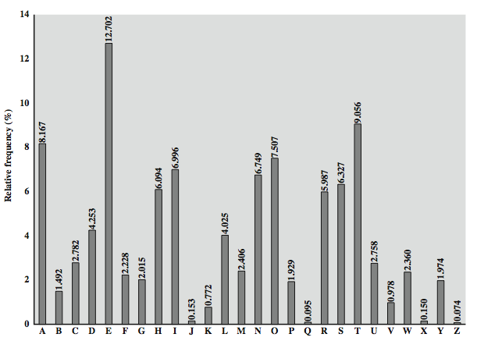
English Letter Frequencies
Notes:
‹#›
Note that all human languages have varying letter frequencies, though the number of letters and their frequencies varies. Stallings Figure 2.5 shows English letter frequencies. Seberry & Pieprzyk, "Cryptography - An Introduction to Computer Security", Prentice-Hall 1989, Appendix A has letter frequency graphs for 20 languages (most European & Japanese & Malay). Also useful are tables of common two-letter combinations, known as digrams, and three-letter combinations, known as trigrams.

Slide 27
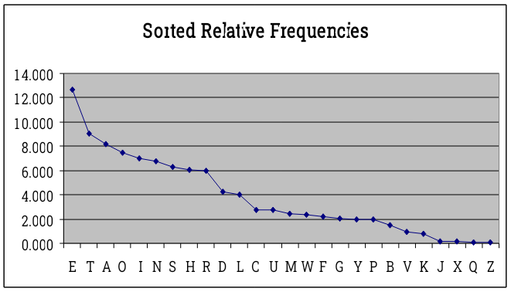
English Letter Frequencies
Notes:
‹#›

Slide 28
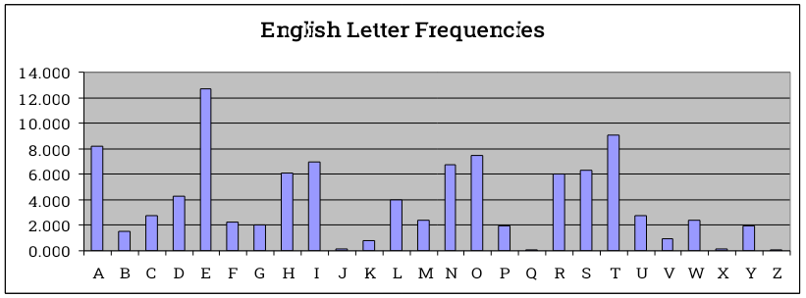
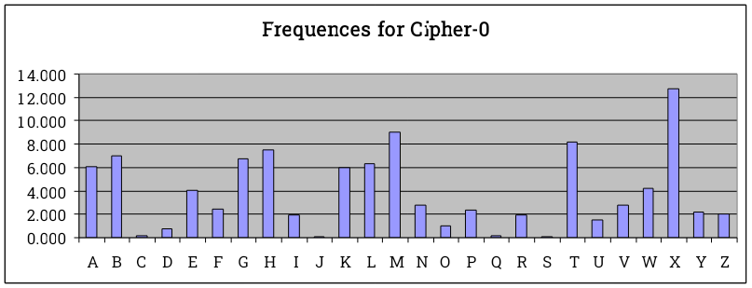
What kind of cipher is this?
Notes:
‹#›
Note that cipher-0 frequency histogram is the same as English only shifted over – must be a rotational cipher!

Slide 29
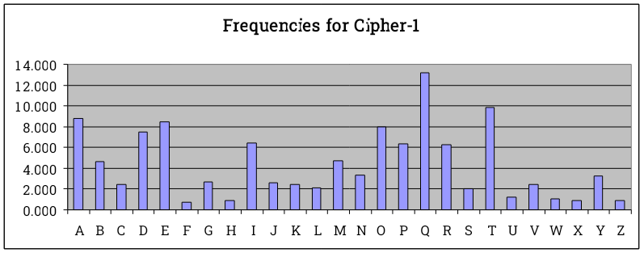
What kind of cipher is this?
Notes:
‹#›
Not the same histogram only shifted – not a rotational cipher.

Slide 30
Use in Cryptanalysis
key concept - monoalphabetic substitution ciphers do not change relative letter frequencies
discovered by Arabian scientists in 9th century
calculate letter frequencies for ciphertext
compare counts/plots against known values
if caesar cipher look for common peaks/troughs
peaks at: A-E-I triple, N-O pair, R-S-T triple
troughs at: J-K, U-V-W-X-Y-Z
for monoalphabetic must identify each letter
tables of common double/triple letters help
(digrams and trigrams)
amount of ciphertext is important – statistics!
Notes:
‹#›
The simplicity and strength of the monoalphabetic substitution cipher meant it dominated cryptographic use for the first millenium AD. It was broken by Arabic scientists. The earliest known description is in Abu al-Kindi's "A Manuscript on Deciphering Cryptographic Messages", published in the 9th century but only rediscovered in 1987 in Istanbul, but other later works also attest to their knowledge of the field. Monoalphabetic ciphers are easy to break because they reflect the frequency data of the original alphabet. The cryptanalyst looks for a mapping between the observed pattern in the ciphertext, and the known source language letter frequencies. If English, look for peaks at: A-E-I triple, NO pair, RST triple, and troughs at: JK, X-Z.
Monoalphabetic ciphers are easy to break because they reflect the frequency data of the original alphabet.

Slide 31
Example Cryptanalysis
given ciphertext:
UZQSOVUOHXMOPVGPOZPEVSGZWSZOPFPESXUDBMETSXAIZ
VUEPHZHMDZSHZOWSFPAPPDTSVPQUZWYMXUZUHSX
EPYEPOPDZSZUFPOMBZWPFUPZHMDJUDTMOHMQ
count relative letter frequencies (see text)
Notes:
‹#›
Illustrate the process with this example from the text in Stallings section 2.2. Comparing letter frequency breakdown with Figure 2.5, it seems likely that cipher letters P and Z are the equivalents of plain letters e and t, but it is not certain which is which. The letters S, U, O, M, and H are all of relatively high frequency and probably correspond to plain letters from the set {a, h, i, n, o, r, s}. The letters with the lowest frequencies (namely, A, B, G, Y, I, J) are likely included in the set {b, j, k, q, v, x, z}. A powerful tool is to look at the frequency of two-letter combinations, known as digrams. A table similar to Figure 2.5 could be drawn up showing the relative frequency of digrams. The most common such digram is th. In our ciphertext, the most common digram is ZW, which appears three times. So we make the correspondence of Z with t and W with h. Then, by our earlier hypothesis, we can equate P with e. Now notice that the sequence ZWP appears in the ciphertext, and we can translate that sequence as "the." This is the most frequent trigram (three- letter combination) in English, which seems to indicate that we are on the right track. Next, notice the sequence ZWSZ in the first line. We do not know that these four letters form a complete word, but if they do, it is of the form th_t. If so, S equates with a. Only four letters have been identified, but already we have quite a bit of the message. Continued analysis of frequencies plus trial and error should easily yield a solution from this point. The complete plaintext, with spaces added between words, is shown on slide.

Slide 32
Example Cryptanalysis
given ciphertext:
UZQSOVUOHXMOPVGPOZPEVSGZWSZOPFPESXUDBMETSXAIZ
VUEPHZHMDZSHZOWSFPAPPDTSVPQUZWYMXUZUHSX
EPYEPOPDZSZUFPOMBZWPFUPZHMDJUDTMOHMQ
guess P & Z are e and t
guess ZW is th and hence ZWP is “the”
proceeding with trial and error finally get:
it was disclosed yesterday that several informal but
direct contacts have been made with political
representatives of the viet cong in moscow
Notes:
‹#›
Illustrate the process with this example from the text in Stallings section 2.2. Comparing letter frequency breakdown with Figure 2.5, it seems likely that cipher letters P and Z are the equivalents of plain letters e and t, but it is not certain which is which. The letters S, U, O, M, and H are all of relatively high frequency and probably correspond to plain letters from the set {a, h, i, n, o, r, s}. The letters with the lowest frequencies (namely, A, B, G, Y, I, J) are likely included in the set {b, j, k, q, v, x, z}. A powerful tool is to look at the frequency of two-letter combinations, known as digrams. A table similar to Figure 2.5 could be drawn up showing the relative frequency of digrams. The most common such digram is th. In our ciphertext, the most common digram is ZW, which appears three times. So we make the correspondence of Z with t and W with h. Then, by our earlier hypothesis, we can equate P with e. Now notice that the sequence ZWP appears in the ciphertext, and we can translate that sequence as "the." This is the most frequent trigram (three- letter combination) in English, which seems to indicate that we are on the right track. Next, notice the sequence ZWSZ in the first line. We do not know that these four letters form a complete word, but if they do, it is of the form th_t. If so, S equates with a. Only four letters have been identified, but already we have quite a bit of the message. Continued analysis of frequencies plus trial and error should easily yield a solution from this point. The complete plaintext, with spaces added between words, is shown on slide.

Slide 33
Playfair Cipher
not even the large number of keys in a monoalphabetic cipher provides security
one approach to improving security was to encrypt multiple letters
the Playfair Cipher is an example
invented by Charles Wheatstone in 1854, but named after his friend Baron Playfair
Notes:
‹#›
Consider ways to reduce the "spikyness" of natural language text, since if just map one letter always to another, the frequency distribution is just shuffled. One approach is to encrypt more than one letter at once. The Playfair cipher is an example of doing this, treats digrams in the plaintext as single units and translates these units into ciphertext digrams.

Slide 34
Playfair Key Matrix
a 5X5 matrix of letters based on a keyword
fill in letters of keyword (sans duplicates)
fill rest of matrix with other letters
eg. using the keyword MONARCHY
M | O | N | A | R
C | H | Y | B | D
E | F | G | I/J | K
L | P | Q | S | T
U | V | W | X | Z
Notes:
‹#›
The best-known multiple-letter encryption cipher is the Playfair, which treats digrams in the plaintext as single units and translates these units into ciphertext digrams. The Playfair algorithm is based on the use of a 5x5 matrix of letters constructed using a keyword. The rules for filling in this 5x5 matrix are: L to R, top to bottom, first with keyword after duplicate letters have been removed, and then with the remain letters, with I/J used as a single letter. This example comes from Dorothy Sayer's book "Have His Carcase", in which Lord Peter Wimsey solves it, and describes the use of a probably word attack.

Slide 35
Encrypting and Decrypting
plaintext is encrypted two letters at a time
if a pair is a repeated letter, insert filler like 'X’
if both letters fall in the same row, replace each with letter to right (wrapping back to start from end)
if both letters fall in the same column, replace each with the letter below it (wrapping to top from bottom)
otherwise each letter is replaced by the letter in the same row and in the column of the other letter of the pair
Notes:
‹#›
Plaintext is encrypted two letters at a time,according to the rules as shown. Note how you wrap from right side back to left, or from bottom back to top.
if a pair is a repeated letter, insert a filler like 'X', eg. "balloon" encrypts as "ba lx lo on"
if both letters fall in the same row, replace each with letter to right (wrapping back to start from end), eg. “ar" encrypts as "RM"
if both letters fall in the same column, replace each with the letter below it (again wrapping to top from bottom), eg. “mu" encrypts to "CM"
otherwise each letter is replaced by the one in its row in the column of the other letter of the pair, eg. “hs" encrypts to "BP", and “ea" to "IM" or "JM" (as desired)
Decrypting of course works exactly in reverse. Can see this by working the example pairs shown, backwards.

Slide 36
Playfair Example
Message = Move forward
Plaintext = mo ve fo rw ar dx
Here x is just a filler, message is padded and segmented
Ciphertext = ON UF PH NZ RM BZ
mo -> ON;
ve -> UF;
fo -> PH, etc.
M | O | N | A | R
C | H | Y | B | D
E | F | G | I/J | K
L | P | Q | S | T
U | V | W | X | Z
Notes:
‹#›
The best-known multiple-letter encryption cipher is the Playfair, which treats digrams in the plaintext as single units and translates these units into ciphertext digrams. The Playfair algorithm is based on the use of a 5x5 matrix of letters constructed using a keyword. The rules for filling in this 5x5 matrix are: L to R, top to bottom, first with keyword after duplicate letters have been removed, and then with the remain letters, with I/J used as a single letter. This example comes from Dorothy Sayer's book "Have His Carcase", in which Lord Peter Wimsey solves it, and describes the use of a probably word attack.

Slide 37
Security of Playfair Cipher
security much improved over monoalphabetic
since have 26 x 26 = 676 digrams
would need a 676 entry frequency table to analyse (versus 26 for a monoalphabetic)
and correspondingly more ciphertext
was widely used for many years
eg. by US & British military in WW1
it can be broken, given a few hundred letters
since still has much of plaintext structure
Notes:
‹#›
The Playfair cipher is a great advance over simple monoalphabetic ciphers, since there are 26*26=676 digrams (vs 26 letters), so that identification of individual digrams is more difficult. Also,the relative frequencies of individual letters exhibit a much greater range than that of digrams, making frequency analysis much more difficult. The Playfair cipher was for a long time considered unbreakable. It was used as the standard field system by the British Army in World War I and still enjoyed considerable use by the U.S.Army and other Allied forces during World War II. Despite this level of confidence in its security, the Playfair cipher is relatively easy to break because it still leaves much of the structure of the plaintext language intact. A few hundred letters of ciphertext are generally sufficient.

Slide 38
Playfair Cipher Use
Advantages:
Simplicity: The Playfair Cipher is easy to use and understand, making it ideal for communication in situations with limited resources.
Historical Use: It was used for secure military communication during wartime because it provided a stronger encryption than simpler ciphers like Caesar Cipher.
Limitations:
Vulnerability to Frequency Analysis: Since it encrypts digraphs (pairs of letters), frequency analysis of letter pairs could break it. This makes it vulnerable to modern cryptanalysis.
Not Secure by Modern Standards: It can be easily broken using computational techniques and is not used for serious encryption today.

Slide 39
Polyalphabetic Ciphers (Vigenere Cipher)
polyalphabetic substitution ciphers
improve security using multiple cipher alphabets
make cryptanalysis harder with more alphabets to guess and flatter frequency distribution
use a key to select which alphabet is used for each letter of the message
use each alphabet in turn
repeat from start after end of key is reached
Notes:
‹#›
One approach to reducing the "spikyness" of natural language text is used the Playfair cipher which encrypts more than one letter at once. We now consider the other alternative, using multiple cipher alphabets in turn. This gives the attacker more work, since many alphabets need to be guessed and because the frequency distribution is more complex, since the same plaintext letter could be replaced by several ciphertext letters, depending on which alphabet is used. The general name for this approach is a polyalphabetic substitution cipher. All these techniques have the following features in common:
A set of related monoalphabetic substitution rules is used.
A key determines which particular rule is chosen for a given transformation.

Slide 40
Vigenère Cipher
simplest polyalphabetic substitution cipher
effectively multiple caesar ciphers
key is multiple letters long K = k₁ k₂ ... k_{d}
i^{th} letter specifies i^{th} alphabet to use
use each alphabet in turn
repeat from start after d letters in message
decryption simply works in reverse
Notes:
‹#›
The best known, and one of the simplest, such algorithms is referred to as the Vigenère cipher, where the set of related monoalphabetic substitution rules consists of the 26 Caesar ciphers, with shifts of 0 through 25. Each cipher is denoted by a key letter, which is the ciphertext letter that substitutes for the plaintext letter ‘a’, and which are each used in turn, as shown next.

Slide 41
Example of Vigenère Cipher
write the plaintext out
write the keyword repeated above it
use each key letter as a caesar cipher key
encrypt the corresponding plaintext letter
eg using keyword deceptive
key: deceptivedeceptivedeceptive
plaintext: wearediscoveredsaveyourself
ciphertext:ZICVTWQNGRZGVTWAVZHCQYGLMGJ
Notes:
‹#›
Discuss this simple example from text Stallings section 2.2.

Slide 42
Aids
simple aids can assist with en/decryption
a Saint-Cyr Slide is a simple manual aid
a slide with repeated alphabet
line up plaintext 'A' with key letter, eg 'C'
then read off any mapping for key letter
can bend round into a cipher disk
or expand into a Vigenère Tableau
Notes:
‹#›
Implementing polyalphabetic ciphers by hand can be very tedious. Various aids were devised to assist the process.
The "Saint-Cyr Slide" was popularised and named by Jean Kerckhoffs, who published a famous early text "La Cryptographie Militaire" (Miltary Cryptography) in 1883. He named the slide after the French National Military Academy where the methods were taught. He also noted that any slide can be expanded into a tableau, or bent round into a cipher disk.
The Vigenère Tableau (given in Stallings 4/e as Table 2.3) is a complete set of forward shifted alphabet mappings.

Slide 43
Security of Vigenère Ciphers
have multiple ciphertext letters for each plaintext letter
hence letter frequencies are obscured
but not totally lost
start with letter frequencies
see if it looks monoalphabetic or not
if not, then need to determine number of alphabets, since then can attack each
Notes:
‹#›
The Vigenère & related polyalphabetic ciphers still do not completely obscure the underlying language characteristics. The strength of this cipher is that there are multiple ciphertext letters for each plaintext letter, one for each unique letter of the keyword. Thus, the letter frequency information is obscured. However, not all knowledge of the plaintext structure is lost. The key to breaking them is to identify the number of translation alphabets, and then attack each separately. If a monoalphabetic substitution is used, then the statistical properties of the ciphertext should be the same as that of the language of the plaintext. If, on the other hand, a Vigenère cipher is suspected, then progress depends on determining the length of the keyword.

Slide 44
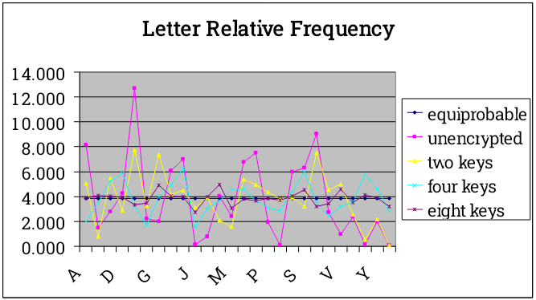
Frequencies After Polyalphabetic Encryption
Notes:
‹#›

Slide 45
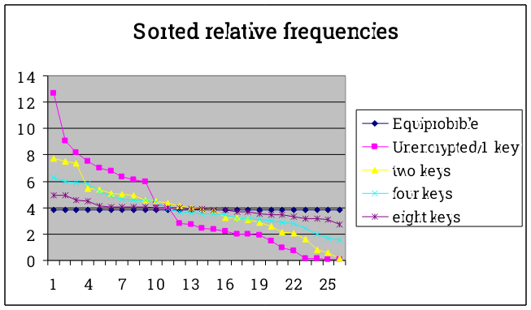
Frequencies After Polyalphabetic Encryption
Notes:
‹#›

Slide 46
Homework 1
Due next class
Question 1:
What is the best “flattening” effect you can achieve by carefully selecting two monoalphabetic substitutions? Explain and give an example. What about three monoalphabetic substitutions?
Notes:
‹#›
For some centuries the Vigenère cipher was le chiffre indéchiffrable (the unbreakable cipher). As a result of a challenge, it was broken by Charles Babbage (the inventor of the computer) in 1854 but kept secret (possibly because of the Crimean War - not the first time governments have kept advances to themselves!). The method was independently reinvented by a Prussian, Friedrich Kasiski, who published the attack now named after him in 1863. However lack of major advances meant that various polyalphabetic substitution ciphers were used into the 20C. One very famous incident was the breaking of the Zimmermann telegram in WW1 which resulted in the USA entering the war. The important is that if two identical sequences of plaintext letters occur at a distance that is an integer multiple of the keyword length, they will generate identical ciphertext sequences.
In general the approach is to find a number of duplicated sequences, collect all their distances apart, look for common factors, remembering that some will be random flukes and need to be discarded. Now have a series of monoalphabetic ciphers, each with original language letter frequency characteristics. Can attack these in turn to break the cipher.

Slide 47
Kasiski Method
method developed by Babbage / Kasiski
repetitions in ciphertext give clues to period
so find same plaintext a multiple of key length apart
which results in the same ciphertext
of course, could also be random fluke
e.g. repeated “VTW” in previous example
distance of 9 suggests key size of 3 or 9
then attack each monoalphabetic cipher individually using same techniques as before
Notes:
‹#›
For some centuries the Vigenère cipher was le chiffre indéchiffrable (the unbreakable cipher). As a result of a challenge, it was broken by Charles Babbage (the inventor of the computer) in 1854 but kept secret (possibly because of the Crimean War - not the first time governments have kept advances to themselves!). The method was independently reinvented by a Prussian, Friedrich Kasiski, who published the attack now named after him in 1863. However lack of major advances meant that various polyalphabetic substitution ciphers were used into the 20C. One very famous incident was the breaking of the Zimmermann telegram in WW1 which resulted in the USA entering the war. The important is that if two identical sequences of plaintext letters occur at a distance that is an integer multiple of the keyword length, they will generate identical ciphertext sequences.
In general the approach is to find a number of duplicated sequences, collect all their distances apart, look for common factors, remembering that some will be random flukes and need to be discarded. Now have a series of monoalphabetic ciphers, each with original language letter frequency characteristics. Can attack these in turn to break the cipher.

Slide 48
Example of Kasiski Attack
Find repeated ciphertext trigrams (e.g., VTW)
May be result of same key sequence and same plaintext sequence (or not)
Find distance(s)
Common factors are likely key lengths
key: deceptivedeceptivedeceptive
plaintext: wearediscoveredsaveyourself
ciphertext:ZICVTWQNGRZGVTWAVZHCQYGLMGJ
Notes:
‹#›
Discuss this simple example from text Stallings section 2.2.

Slide 49
Autokey Cipher
ideally want a key as long as the message
Vigenère proposed the autokey cipher
with keyword is prefixed to message as key
knowing keyword can recover the first few letters
use these in turn on the rest of the message
but still have frequency characteristics to attack
eg. given key deceptive
key: deceptivewearediscoveredsav
plaintext: wearediscoveredsaveyourself
ciphertext:ZICVTWQNGKZEIIGASXSTSLVVWLA
Notes:
‹#›
Taking the polyalphabetic idea to the extreme, want as many different translation alphabets as letters in the message being sent. One way of doing this with a smallish key, is to use the Autokey cipher.
The example uses the keyword "DECEPTIVE" prefixed to as much of the message "WEAREDISCOVEREDSAV" as is needed. When deciphering, recover the first 9 letters using the keyword "DECEPTIVE". Then instead of repeating the keyword, start using the recovered letters from the message "WEAREDISC". As recover more letters, have more of key to recover later letters.
Problem is that the same language characteristics are used by the key as the message. ie. a key of 'E' will be used more often than a 'T' etc hence an 'E' encrypted with a key of 'E' occurs with probability (0.1275)2 = 0.01663, about twice as often as a 'T' encrypted with a key of 'T' have to use a larger frequency table, but it exists given sufficient ciphertext this can be broken.

Slide 50
Homophone Cipher
rather than combine multiple monoalphabetic ciphers, can assign multiple ciphertext characters to same plaintext character
assign number of homophones according to frequency of plaintext character
Gauss believed he made unbreakable cipher using homophones
but still have digram/trigram frequency characteristics to attack
e.g., have 58 ciphertext characters, with each plaintext character assigned to ceil(freq/2) ciphertext characters – so e has 7 homophones, t has 5, a has 4, j has 1, q has 1, etc.
Notes:
‹#›
Taking the polyalphabetic idea to the extreme, want as many different translation alphabets as letters in the message being sent. One way of doing this with a smallish key, is to use the Autokey cipher.
The example uses the keyword "DECEPTIVE" prefixed to as much of the message "WEAREDISCOVEREDSAV" as is needed. When deciphering, recover the first 9 letters using the keyword "DECEPTIVE". Then instead of repeating the keyword, start using the recovered letters from the message "WEAREDISC". As recover more letters, have more of key to recover later letters.
Problem is that the same language characteristics are used by the key as the message. ie. a key of 'E' will be used more often than a 'T' etc hence an 'E' encrypted with a key of 'E' occurs with probability (0.1275)2 = 0.01663, about twice as often as a 'T' encrypted with a key of 'T' have to use a larger frequency table, but it exists given sufficient ciphertext this can be broken.

Slide 51
Vernam Cipher
ultimate defense is to use a key as long as the plaintext
with no statistical relationship to it
invented by AT&T engineer Gilbert Vernam in 1918
specified in U.S. Patent 1,310,719, issued July 22, 1919
originally proposed using a very long but eventually repeating key
used electromechanical relays
Notes:
The ultimate defense against such a cryptanalysis is to choose a keyword that is as long as the plaintext and has no statistical relationship to it. Such a system was introduced by an AT&T engineer named Gilbert Vernam in 1918. His system works on binary data (bits0 rather than letters. The system can be expressed succinctly as follows: c_{i} = p_{i} XOR k_{i}
The essence of this technique is the means of construction of the key. Vernam proposed the use of a running loop of tape that eventually repeated the key, so that in fact the system worked with a very long but repeating keyword. Although such a scheme, with a long key, presents formidable cryptanalytic difficulties, it can be broken with sufficient ciphertext, the use of known or probable plaintext sequences, or both.
‹#›

Slide 52
One-Time Pad
if a truly random key as long as the message is used, the cipher will be secure
called a One-Time pad (OTP)
is unbreakable since ciphertext bears no statistical relationship to the plaintext
since for any plaintext & any ciphertext there exists a key mapping one to other
can only use the key once though
problems in generation & safe distribution of key
Notes:
‹#›
The One-Time Pad is an evolution of the Vernham cipher. An Army Signal Corp officer, Joseph Mauborgne, proposed an improvement using a random key that was truly as long as the message, with no repetitions, which thus totally obscures the original message. It produces random output that bears no statistical relationship to the plaintext. Because the ciphertext contains no information whatsoever about the plaintext, there is simply no way to break the code, since any plaintext can be mapped to any ciphertext given some key.
The one-time pad offers complete security but, in practice, has two fundamental difficulties:
There is the practical problem of making large quantities of random keys.
And the problem of key distribution and protection, where for every message to be sent, a key of equal length is needed by both sender and receiver.
Because of these difficulties, the one-time pad is of limited utility, and is useful primarily for low-bandwidth channels requiring very high security. The one-time pad is the only cryptosystem that exhibits what is referred to as perfect secrecy.

Slide 53
Transposition Ciphers
now consider classical transposition or permutation ciphers
these hide the message by rearranging the letter order
without altering the actual letters used
can recognise these since have the same frequency distribution as the original text
Notes:
‹#›
All the techniques examined so far involve the substitution of a ciphertext symbol for a plaintext symbol. A very different kind of mapping is achieved by performing some sort of permutation on the plaintext letters. This technique is referred to as a transposition cipher, and form the second basic building block of ciphers. The core idea is to rearrange the order of basic units (letters/bytes/bits) without altering their actual values.

Slide 54
Rail Fence cipher
write message letters out diagonally over a number of rows
then read off cipher row by row
eg. write message out as:
m e m a t r h t g p r y
e t e f e t e o a a t
giving ciphertext
MEMATRHTGPRYETEFETEOAAT
Notes:
‹#›
The simplest such cipher is the rail fence technique, in which the plaintext is written down as a sequence of diagonals and then read off as a sequence of rows.
The example message is: "meet me after the toga party" with a rail fence of depth 2.
This sort of thing would be trivial to cryptanalyze.

Slide 55
Row Transposition Ciphers
is a more complex transposition
write letters of message out in rows over a specified number of columns
then reorder the columns according to some key before reading off the rows
Key: 4312567
Column Out 4 3 1 2 5 6 7
Plaintext: a t t a c k p
o s t p o n e
d u n t i l t
w o a m x y z
Ciphertext: TTNAAPTMTSUOAODWCOIXKNLYPETZ
Notes:
‹#›
A more complex transposition cipher is to write the message in a rectangle, row by row, and read the message off shuffling the order of the columns in each row. The order of the columns then becomes the key to the algorithm. In the example shown, the key is 4312567, that is use column 4 first, then column3, then 1 etc (as shown in the Column Out row).
A pure transposition cipher is easily recognized because it has the same letter frequencies as the original plaintext. For the type of columnar transposition just shown, cryptanalysis is fairly straightforward and involves laying out the ciphertext in a matrix and playing around with column positions. Digram and trigram frequency tables can be useful.

Slide 56
Block Transposition Ciphers
arbitrary block transposition may be used
specify permutation on block
repeat for each block of plaintext
Key: 4931285607
Plaintext: attackpost poneduntil twoamxyzab
Ciphertext: CTATTSKPAO DLEONIDUPT MBAWOAXYTZ
Notes:
‹#›
A more complex transposition cipher is to write the message in a rectangle, row by row, and read the message off shuffling the order of the columns in each row. The order of the columns then becomes the key to the algorithm. In the example shown, the key is 4312567, that is use column 4 first, then column3, then 1 etc (as shown in the Column Out row).
A pure transposition cipher is easily recognized because it has the same letter frequencies as the original plaintext. For the type of columnar transposition just shown, cryptanalysis is fairly straightforward and involves laying out the ciphertext in a matrix and playing around with column positions. Digram and trigram frequency tables can be useful.

Slide 57
Homework 1
Due next class
Question 2:
Mathematically specify an arbitrary block transposition cipher with block length B and permutation π:[0..B-1] → [0..B-1] for plaintext P=p₀p₁p₂p₃…p_{N-1}, where N is a multiple of B.
Notes:
‹#›
For some centuries the Vigenère cipher was le chiffre indéchiffrable (the unbreakable cipher). As a result of a challenge, it was broken by Charles Babbage (the inventor of the computer) in 1854 but kept secret (possibly because of the Crimean War - not the first time governments have kept advances to themselves!). The method was independently reinvented by a Prussian, Friedrich Kasiski, who published the attack now named after him in 1863. However lack of major advances meant that various polyalphabetic substitution ciphers were used into the 20C. One very famous incident was the breaking of the Zimmermann telegram in WW1 which resulted in the USA entering the war. The important is that if two identical sequences of plaintext letters occur at a distance that is an integer multiple of the keyword length, they will generate identical ciphertext sequences.
In general the approach is to find a number of duplicated sequences, collect all their distances apart, look for common factors, remembering that some will be random flukes and need to be discarded. Now have a series of monoalphabetic ciphers, each with original language letter frequency characteristics. Can attack these in turn to break the cipher.

Slide 58
Product Ciphers
ciphers using substitutions or transpositions are not secure because of language characteristics
hence consider using several ciphers in succession to make harder, but:
two substitutions make a more complex substitution
two transpositions make more complex transposition
but a substitution followed by a transposition makes a new much harder cipher
this is bridge from classical to modern ciphers
Notes:
‹#›
Have seen that ciphers based on just substitutions or transpositions are not secure, and can be attacked because they do not sufficient obscure the underlying language structure
So consider using several ciphers in succession to make harder.
A substitution followed by a transposition is known as a Product Cipher, and makes a new much more secure cipher, and forms the bridge to modern ciphers.

Slide 59
Homework 1
Due next class
Question 3: (be mathematical)
What is the result of the product of two rotational substitutions?
What is the result of the product of two affine substitutions?
What is the result of the product of two block transpositions?
Notes:
‹#›
For some centuries the Vigenère cipher was le chiffre indéchiffrable (the unbreakable cipher). As a result of a challenge, it was broken by Charles Babbage (the inventor of the computer) in 1854 but kept secret (possibly because of the Crimean War - not the first time governments have kept advances to themselves!). The method was independently reinvented by a Prussian, Friedrich Kasiski, who published the attack now named after him in 1863. However lack of major advances meant that various polyalphabetic substitution ciphers were used into the 20C. One very famous incident was the breaking of the Zimmermann telegram in WW1 which resulted in the USA entering the war. The important is that if two identical sequences of plaintext letters occur at a distance that is an integer multiple of the keyword length, they will generate identical ciphertext sequences.
In general the approach is to find a number of duplicated sequences, collect all their distances apart, look for common factors, remembering that some will be random flukes and need to be discarded. Now have a series of monoalphabetic ciphers, each with original language letter frequency characteristics. Can attack these in turn to break the cipher.

Slide 60
Rotor Machines
before modern ciphers, rotor machines were most common complex ciphers in use
widely used in WW2
German Enigma, Allied Hagelin, Japanese Purple
implemented a very complex, varying substitution cipher
used a series of cylinders, each giving one substitution, which rotated and changed after each letter was encrypted
with 3 cylinders have 26³=17576 alphabets
Notes:
‹#›
The next major advance in ciphers required use of mechanical cipher machines which enabled to use of complex varying substitutions.
A rotor machine consists of a set of independently rotating cylinders through which electrical pulses can flow. Each cylinder has 26 input pins and 26 output pins, with internal wiring that connects each input pin to a unique output pin. If we associate each input and output pin with a letter of the alphabet, then a single cylinder defines a monoalphabetic substitution. After each input key is depressed, the cylinder rotates one position, so that the internal connections are shifted accordingly. The power of the rotor machine is in the use of multiple cylinders, in which the output pins of one cylinder are connected to the input pins of the next, and with the cylinders rotating like an “odometer”, leading to a very large number of substitution alphabets being used, eg with 3 cylinders have 26³=17576 alphabets used.
They were extensively used in world war 2, and the history of their use and analysis is one of the great stories from WW2.

Slide 61
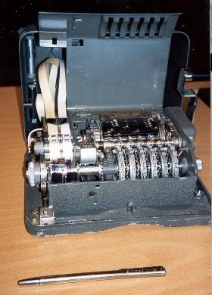
Hagelin Rotor Machine
Notes:
‹#›
This photo of an Allied Hagelin machine was taken by Lawrie Brown at Eurocrypt'93 in Norway. Note pen for scale, and the rotating cipher wheels near the front.

Slide 62
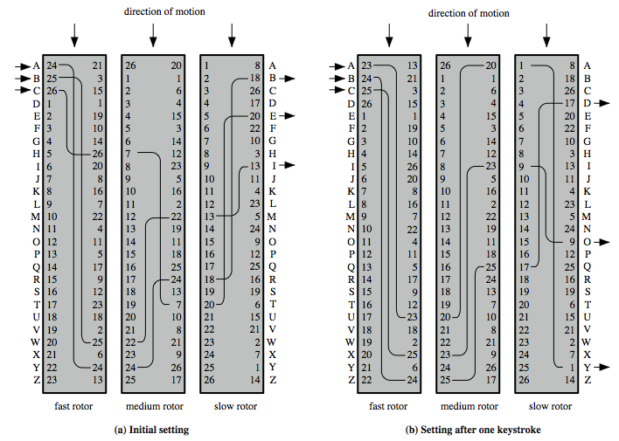
Rotor Machine Principles
Notes:
The basic principle of the rotor machine is illustrated in Figure 2.8. The machine consists of a set of independently rotating cylinders through which electrical pulses can flow. Each cylinder has 26 input pins and 26 output pins, with internal wiring that connects each input pin to a unique output pin. If we associate each input and output pin with a letter of the alphabet, then a single cylinder defines a monoalphabetic substitution. If an operator depresses the key for the letter A, an electric signal is applied to the first pin of the first cylinder and flows through the internal connection to the twenty-fifth output pin. Consider a machine with a single cylinder. After each input key is depressed, the cylinder rotates one position, so that the internal connections are shifted accordingly. Thus, a different monoalphabetic substitution cipher is defined. After 26 letters of plaintext, the cylinder would be back to the initial position. Thus, we have a polyalphabetic substitution algorithm with a period of 26.
A single-cylinder system is trivial and does not present a formidable cryptanalytic task. The power of the rotor machine is in the use of multiple cylinders, in which the output pins of one cylinder are connected to the input pins of the next. Figure 2.8 shows a three-cylinder system. With multiple cylinders, the one closest to the operator input rotates one pin position with each keystroke. The right half of Figure 2.8 shows the system's configuration after a single keystroke. For every complete rotation of the inner cylinder, the middle cylinder rotates one pin position. Finally, for every complete rotation of the middle cylinder, the outer cylinder rotates one pin position. The result is that there are 26 " 26 " 26 = 17,576 different substitution alphabets used before the system repeats.
‹#›

Slide 63
Homework 1
Due next class
Question 4:
Give a mathematical description of a two-rotor cipher.
Notes:
‹#›
For some centuries the Vigenère cipher was le chiffre indéchiffrable (the unbreakable cipher). As a result of a challenge, it was broken by Charles Babbage (the inventor of the computer) in 1854 but kept secret (possibly because of the Crimean War - not the first time governments have kept advances to themselves!). The method was independently reinvented by a Prussian, Friedrich Kasiski, who published the attack now named after him in 1863. However lack of major advances meant that various polyalphabetic substitution ciphers were used into the 20C. One very famous incident was the breaking of the Zimmermann telegram in WW1 which resulted in the USA entering the war. The important is that if two identical sequences of plaintext letters occur at a distance that is an integer multiple of the keyword length, they will generate identical ciphertext sequences.
In general the approach is to find a number of duplicated sequences, collect all their distances apart, look for common factors, remembering that some will be random flukes and need to be discarded. Now have a series of monoalphabetic ciphers, each with original language letter frequency characteristics. Can attack these in turn to break the cipher.

Slide 64
Rotor Ciphers
Each rotor implements some permutation between its input and output contacts
Rotors turn like an odometer on each key stroke (rotating input and output contacts)
Key is the sequence of rotors and their initial positions
Notes:
‹#›
For some centuries the Vigenère cipher was le chiffre indéchiffrable (the unbreakable cipher). As a result of a challenge, it was broken by Charles Babbage (the inventor of the computer) in 1854 but kept secret (possibly because of the Crimean War - not the first time governments have kept advances to themselves!). The method was independently reinvented by a Prussian, Friedrich Kasiski, who published the attack now named after him in 1863. However lack of major advances meant that various polyalphabetic substitution ciphers were used into the 20C. One very famous incident was the breaking of the Zimmermann telegram in WW1 which resulted in the USA entering the war. The important is that if two identical sequences of plaintext letters occur at a distance that is an integer multiple of the keyword length, they will generate identical ciphertext sequences.
In general the approach is to find a number of duplicated sequences, collect all their distances apart, look for common factors, remembering that some will be random flukes and need to be discarded. Now have a series of monoalphabetic ciphers, each with original language letter frequency characteristics. Can attack these in turn to break the cipher.

Slide 65
Steganography
an alternative to encryption
hides existence of message
using only a subset of letters/words in a longer message marked in some way
using invisible ink
hiding in LSB in graphic image or sound file
hide in “noise”
has drawbacks
high overhead to hide relatively few info bits
advantage is can obscure encryption use
Notes:
‹#›
Steganography is an alternative to encryption which hides the very existence of a message by some means. There are a large range of techniques for doing this.
Steganography has a number of drawbacks when compared to encryption. It requires a lot of overhead to hide a relatively few bits of information.
Also, once the system is discovered, it becomes virtually worthless, although a message can be first encrypted and then hidden using steganography. The advantage of steganography is that it can be employed by parties who have something to lose should the fact of their secret communication (not necessarily the content) be discovered.

Slide 66
Summary
have considered:
classical cipher techniques and terminology
monoalphabetic substitution ciphers
cryptanalysis using letter frequencies
Playfair cipher
polyalphabetic ciphers
transposition ciphers
product ciphers and rotor machines
steganography
Notes:
‹#›
Chapter 2 summary.

Slide 67
a b c d e f g h i j k
0 1 2 3 4 5 6 7 8 9 10
l m n o p q r s
11 12 13 14 15 16 17 18
t u v w x y z
19 20 21 22 23 24 25

